Slide 1
Prostate
Function: Secrete alkaline fluid
Size: walnut size (15 grams)
Benign Prostatic Hyperplasia: a benign tumor of the prostate gland
Benign: a tumor that doesn't metastasize
Prostatic: prostate
Hyperplasia: increase in # cells (not size)
Cause of BPH
1. increase in DHT
Treat: 5-alpha reductase inhibitors
2. excess alpha adrenergic SM tone → contraction of prostate gland
Treat: Alpha blockers
Symptoms of BPH
L- Lower
U - Urinary
T - Tract
S – Symptoms
 | Mild | Moderate | Bad
Emptying | Incomplete emptying | Dribbling (droplets) | Dysuria: painful
Frequency | Hesitancy | urgency | nocturia
Urgency | Urge incontinence | Abdominal Straining | Decrease force
Complications
Renal insufficiency Acute renal failure Recurrent UTI Bladder Stones
Notes:
http://www.ncbi.nlm.nih.gov/books/NBK52272/

Slide 2
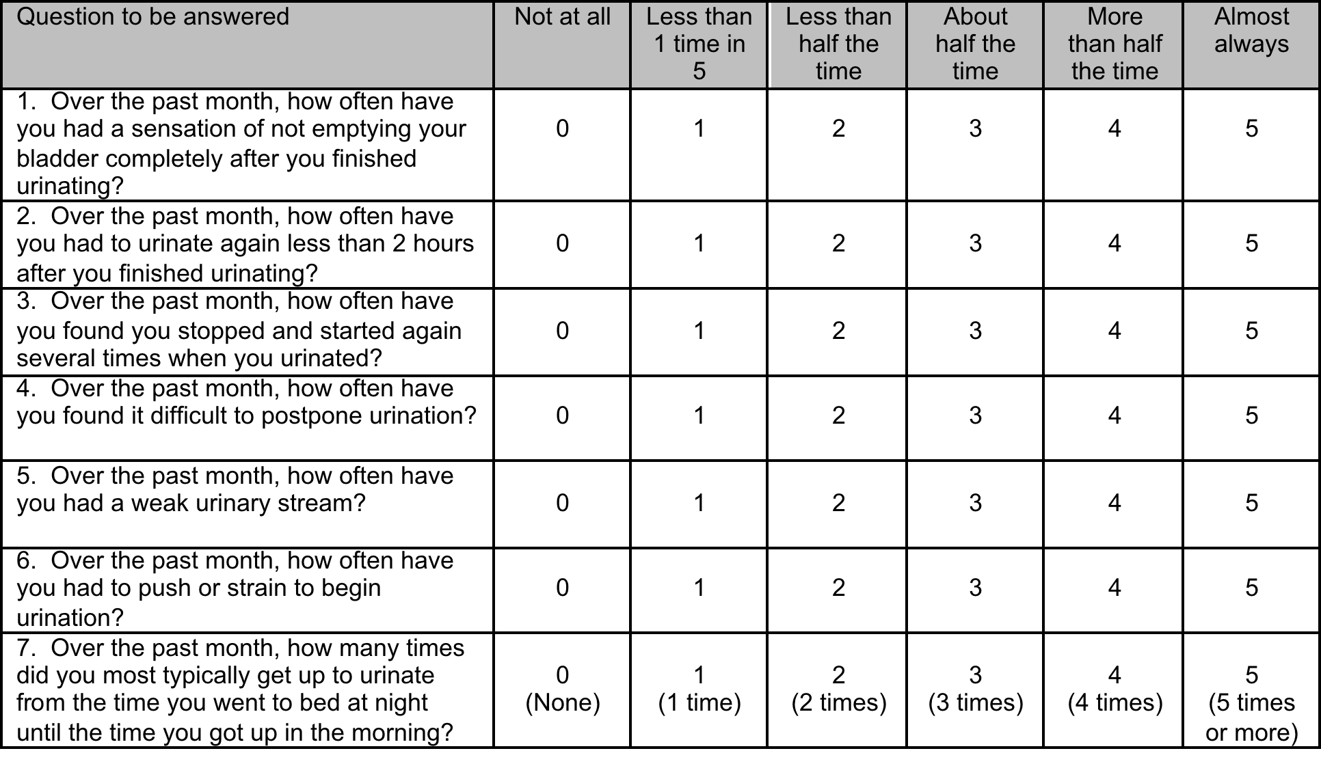
Epidemiology
puberty 1st prostate growth spurt
Age 40: 2nd Prostate growth spurt
Age > 50 Most common benign tumor in men
Age 60 50% change of BPH
Age 85 90% change of BPH
Diagnosis: (American Urological Association) AUA Score
Mild: < 7
Moderate: 8-19
Severe > 20

Slide 3
BPH
Mild
Moderate
Severe
Or
Complications:
Renal insufficiency
Recurrent UTI
Bladder Stones
Monitor
Qyear
Council: limiting fluid intake after dinner and avoiding decongestants
Alpha Blocker
Or
5 alpha-Reductase Inhibitor
Or
(Maybe Cialis)
Surgery

Slide 4
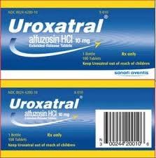
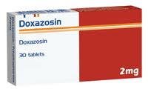


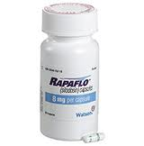
Alpha 1 Adrenergic Blockers
MOA: Block Alpha 1 Receptors → SM relaxation in prostatic Capsule, bladder and Urethra
Pros
Improve AUA score by 30 – 40% & help with BP
Cons:
No effect on PSA (prostate specific antigen) → no decrease in prostate size
Non-Selective blockers
Selective blockers
 | Doxazosin (Cardura) | Terazosin (Hytrin) | Alfuzosin (UroXatral) | Silodosin (Rapaflo) | Tamsulosin (Flomax)
Indication | BPH HTN | BPH HTN | BPH | BPH | BPH
Dosing | 1 mg qHS Max 8 mg | 1 mg qHS Max 10 mg | 10 mg daily Can w/ food | 8 mg daily | 0.4 mg daily Empty stomach
CrCl (ml/min) | No renal | No renal | Caution if CrCl < 30 | CrCl 30 – 50 4 mg daily | none
Contra |  |  |  | CrCl < 30
SE: HA, dizzy | SOB | Nasal congestion | Fatigue | Nasal congestion | Decrease libido
D-D: lower BP CYP |  | No hepatic | CYP3A4 | P-gp inhibitor CYP3A4 | Cimetidine CYP3A4
Comments | Syncope | Syncope | Lowest ejaculatory dysfunction | Abnormal ejaculation Little dizzy | dizzy
Notes:
Doxazosin Cardura dock for car
Terazosin Hytrin teratogen = red hydra
Alfuzosin UroXatral alphU, U’re ox a trail
Silodosin Rapaflo silly raffa flow
Tamsulosin flomax

Slide 5
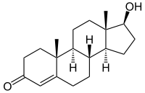
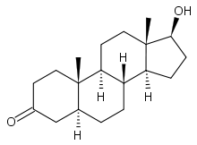
5-Alpha Reductase Inhibitors
MOA: decrease DHT that causes:
1. Prostate Cell Growth
2. Hair Loss
Drug:
Finasteride 5 mg PO daily
Dutasteride 0.5 mg PO daily
Pros:
No renal/hepatic dose adjustments
Reduce Prostate Size by 25%
Combo: Finasteride + Doxazosin
Cons:
Slow onset
Size/symptoms return to baseline if d/c
Monitor
q6 months: if prostate does not decrease by 50% then check for prostate cancer
AUA symptom score
Adverse effects
GI
HA/dizzy
Abdominal
Sexual dysfunction
Testosterone
Finasteride
Dutasteride
5 alpha reductase
DHT
DHT-1 Receptor
Hair loss
DHT-2 Receptor
Prostate Cell growth
Notes:
-asteride the fish
Fin = five
Duasteride = Ouristeride = 0.5

Slide 6
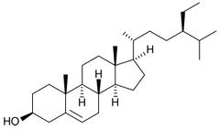
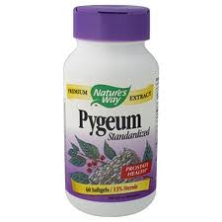
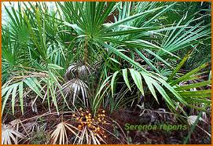
Drugs to avoid if patient has BPH
Drug Reason
Testosterone replacement increase DHT
Alpha agonist (decongestants) opposite of alpha 1 antagonist
Anti-cholinergics (TCA, H1) run from bear = no pee
Diuretics
Herbal Therapy
Insufficient Evidence | Possibly effective | Likely effective
Garlic | African wild potato | Beta-sitosterol
Prickly pear cactus | Pumpkin | Pygeum
Red clover | Rye grass | Saw palmetto
Stinging nettle

